Slide 1
Creating a story and a logical action plan from raw data
By Arthur Dryver, PhD¹
¹Graduate School of Business Administration, NIDA
Email: dryver@gmail.com URL: www.LearnViaWeb.com

Slide 2
My Background – High Level
Presently teaching within the School of Business Administration at NIDA, Bangkok Thailand (Been teaching there over 9- years)
Worked in consulting in America for 4 years – first firm worked for was PriceWaterhouseCoopers
Representative Companies consulted for:
General Electric, JCPenney, United States Postal Services, many more …
Ph.D. in Statistics from Pennsylvania State University
Undergraduate at Rice University, TX
B.A. in Mathematical Sciences/Statistics

Slide 3
Classes Taught
From basic to advanced statistics for business majors within graduate programs – mainly masters students.
Mostly basic statistics up to multiple regression.
The classes sizes are usually small – about 10-15 students.
I expect students to utilize Excel and PPT for presentations and use SPSS for most of the statistical tests.

Slide 4
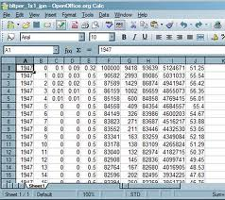
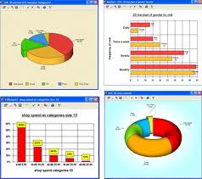
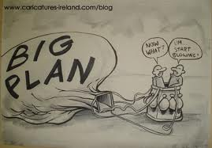
A large problem: turning data into a story. This is important in the work force.
Missing a link
Unfortunately, there is usually a big disconnect between the graphs presented and the recommendations. Partly due to misinterpretation of the graphs.

Slide 5
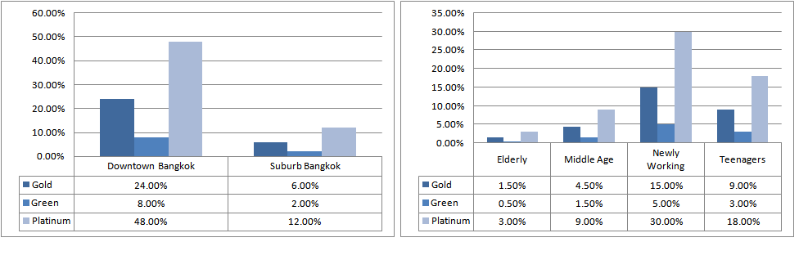
The importance of understanding joint probability versus conditional probability
You are with the marketing division of your company. The platinum package is the most profitable. You are investigating the relationship between where your customers live and what package they buy. You are also investigating the relationship between age category and package purchased. Using the graphs below choose your strategy to sell the platinum package and reason.
Circle one of the following:
Knowing age and location doesn't help determine if they will buy the platinum package or not.
Focus your marketing on downtown Bangkok because they are the groups most likely to purchase the platinum package.
Focus your marketing on newly working because they are the groups most likely to purchase the platinum package.
Focus your marketing on downtown Bangkok and newly working because those two groups combined comprise the largest group most likely to purchase the platinum package.

Slide 6
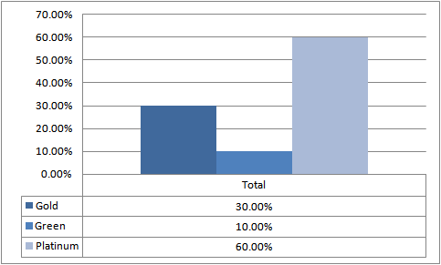
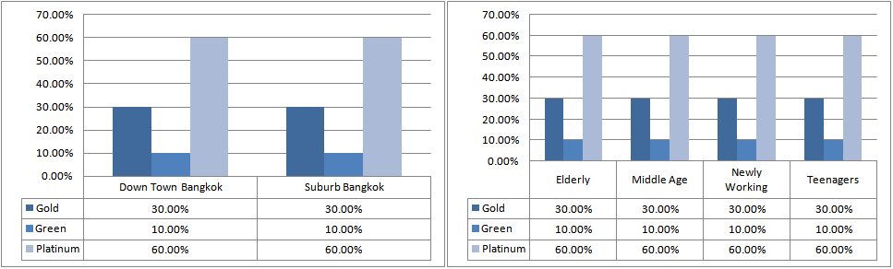
The importance of understanding joint probability versus conditional probability
Correct Answer: Knowing age and location doesn't help determine if they will buy the platinum package or not.
Most people can’t differentiate between most prevalent and a relationship when looking at joint probability.

Slide 7
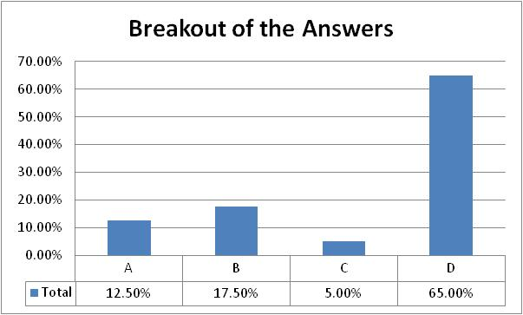
The importance of understanding joint probability versus conditional probability
Correct Answer: Knowing age and location doesn't help determine if they will buy the platinum package or not.
If people can’t interpret graphs correctly then they can’t create accurate stories with action plans that follow from the data correctly.
The survey responses, "A" is the correct answer. 80 students from undergraduate business class.

Slide 8
Summary
As the saying goes: “You can’t judge a book by its cover.”
What would one do if he/she couldn’t read
Thus ultimately it is very important to at least ensure our students can read and interpret graphs properly.

