Slide 1
Review of Simple Linear Regression
Associate Professor Arthur Dryver, PhD
School of Business Administration, NIDA
Email: arthur@kaizen90.com
url: www.learnviaweb.com

Slide 2

Success is not advanced statistics. Success is a better business strategy.
More business intelligence from your data.

Slide 3
Modeling Techniques
Regression and logistic

Slide 4
Advanced modeling techniques
Often the basic descriptive statistics are enough.
Two common techniques when advanced statistics are required
  General linear model
    Regression can be considered a subset of this
  Logistic regression

Slide 5
Regression
Understanding The Basics of Regression: Continuous Independent Variable

Slide 6
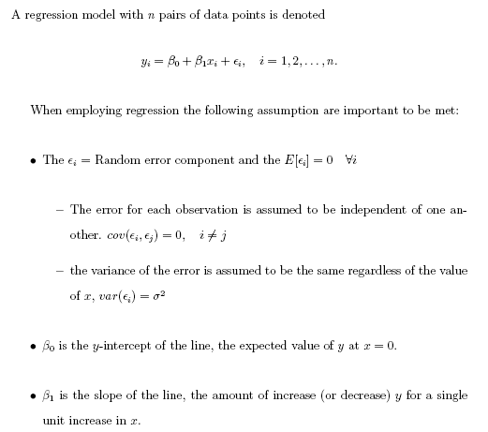
Regression

Slide 7
Solve slope and intercept only using the concept. No calculator needed
X | Y
0 1 2 3 | 2 3 4 5
Solve for
intercept
slope

Slide 8
X | Y
0 1 2 3 | 2 3 4 5
1
1
1
1
1
1
Solve for

Slide 9
Solve slope and intercept only using the concept. No calculator needed
X | Y
0 2 4 6 | 2 4 6 8
Solve for
intercept
slope

Slide 10
X | Y
0 2 4 6 | 2 4 6 8
2
2
2
2
2
2
Solve for

Slide 11
Solve slope and intercept only using the concept. No calculator needed
X | Y
0 1 2 3 | 4 6 8 10
Solve for
intercept
slope

Slide 12
X | Y
0 1 2 3 | 4 6 8 10
2
2
2
Solve for
intercept
slope

Slide 13
Solve slope and intercept only using the concept. No calculator needed
X | Y
0 1 2 3 | 10 7 4 1
Solve for

Slide 14
X | Y
0 1 2 3 | 10 7 4 1
-3
-3
-3
Solve for

Slide 15
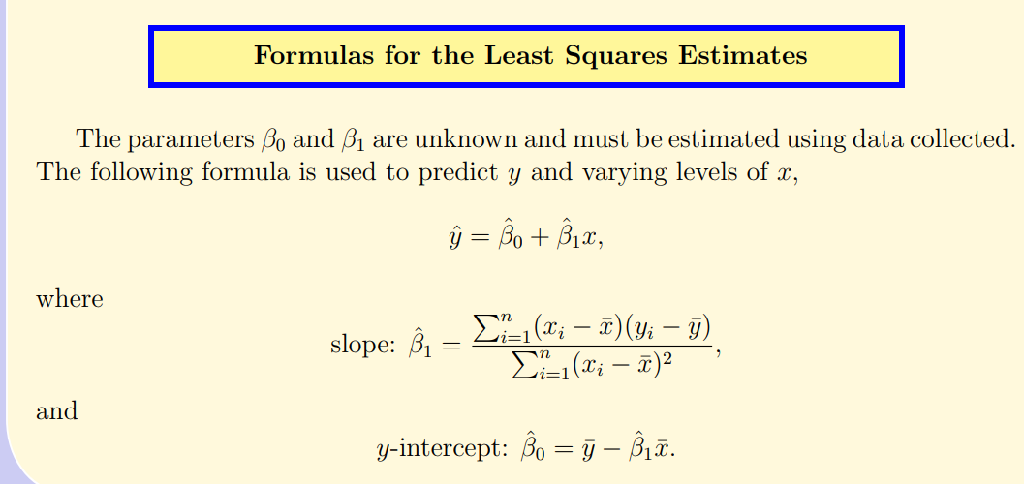
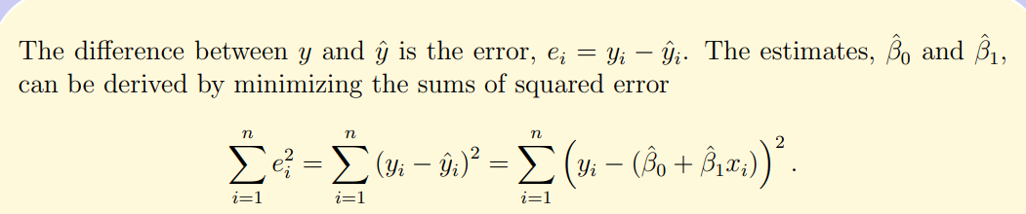

Slide 16
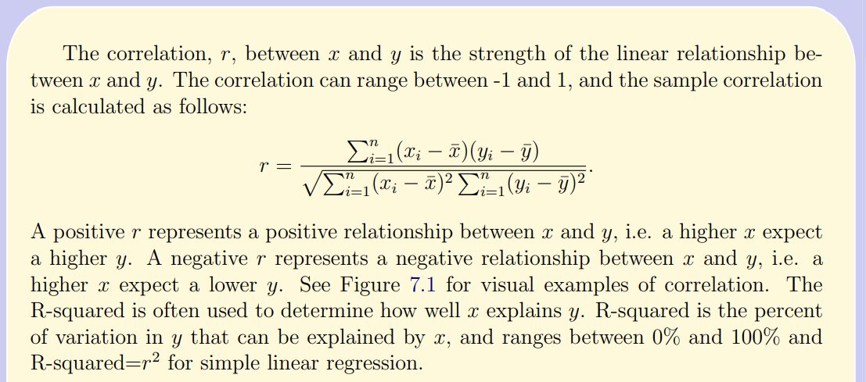

Slide 17
Correlation Fig 7.1
1)
2)
y
y
Extremely high Positive Correlated
High Positive Correlation
v
v
x
x
3)
4)
y
y
High Negative Correlation
No Correlation
x
x

Slide 18
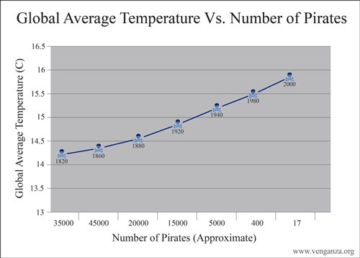

Slide 19
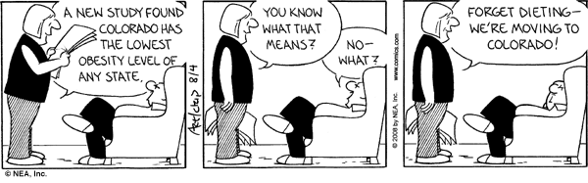
Correlation does not equal causation

Slide 20
Regression
Understanding The Residuals

Slide 21
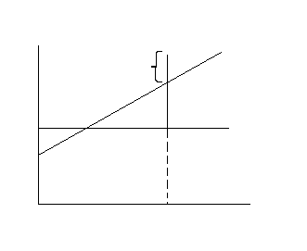
Representation of the regression line
The difference between actual and estimated.

Slide 22
Facts In Regression
The residuals sum to zero.
The residual times x_{i} sum to zero.
The residual times yhat_i sum to zero.

Slide 23
More Facts In Regression
The sum of the y_i equals the sum of the yhat_i
The residuals sum to zero. This is one reason why we look at the sum of the residuals squared. SSE (Sum of Squares Error)
The regression line always goes through the point (xbar,ybar). Thus when x=xbar yhat=ybar. That is if you solve for yhat at xbar you will get ybar.

Slide 24
More Facts In Regression
SST (Sum of Squares Total)
SSR (Sum of Squares Regression)
SSE (Sum of Squares Error)
Should be (y-yhat)^2
SST=SSR+SSE

Slide 25
R-Squared
R-Squared is the percent of variation in y explained by the independent variable(s) x.

Slide 26
Adjusted R-Squared
Adjusted R-Squared is adjusted for the number of variables used in the general linear model. The “n” is the sample size and “p” is the number of independent variables in the model.

Slide 27
R-Squared and Adjusted R-Squared
Are measures to indicate how well the model performs. Sample “Goodness of Fit” measures. Does x explain y and if so, how well does x explain y?
  R-Squared and Adjusted R-Squared helps to answer this question.
  If a variable is added to the model R-Squared will always stay the same or increase.
  Adjusted R-Squared helps understand if it is worth adding another variable. A drop in the Adjusted R-Squared leads one to believe that perhaps the additional variable is not helpful in explaining y.
Stepwise techniques can help quickly reduce the number of variables in the model, it is an automated procedure.

Slide 28
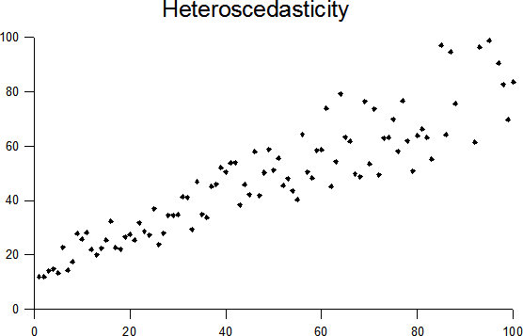
Regression assumes variance of error will be consistent with x.
Transforming the data may help, like taking the natural log of X. For marketing in my opinion this issue isn’t a major concern. In the end you must check model performance and then decide to move forward or not.

Slide 29
Multicolinearity
When two variables are highly correlated and both are in the model they can cause multicolinearity.
  Difficult to understand what the individual contribution of a variable is.
Test the correlation among the independent variables to check for multicolinearity.
Possibly drop one variable if they are highly correlated and little value is added by keeping both.

Slide 30
Autocorrelation
This occurs when dealing with time series data:
  For example predicting phone usage using previous usage data points.
Time series is beyond this course.
For estimating revenue you may wish to use a simple time series technique such as an exponentially moving average:
  You could give a higher weight to the most recent month and less weight to the previous months revenue.
  Also, may wish to consider any change in plan, like adding or subtracting cable for a more accurate picture of revenue for customer value.

Slide 31
Sometimes we may wish to make more than one model
Sometimes we may wish to make more than one model.
  For example separating out certain customers like platinum package cable renters.
    Perhaps they behave differently
It is better to make 2-3 good performing models than a single model that does okay on all the data.
  Next few slides illustrate this concept.
There are advanced techniques that can be applied to make a single complicated model.
  With 15 million customers to draw from, I don’t believe it is worth the added complication.

Slide 36
outlier

Slide 41
Questioning The Model
Are the assumptions met? What are the assumptions (we haven’t fully discussed this yet, next slide).
Is the model assumed the correct model?
Should transformations be used to create a better model?
Are there outliers and if so should we remove them?
Does the model truly answer the questions you are interested in answering.
Etc.

Slide 42
Calculations - Formulas
For Simple Linear Regress

Slide 44




















Slide 45




Confidence Interval (CI) and Prediction Interval (PI)

Slide 46
Incorporating Categorical Data
This is for when get to multiple regression.

Slide 47
Categorical Data: Coding
Dummy variables or Indicator variables take values of 0 or 1
  Example:
  Gender: A possible dummy variable for Gender:
Take 2 minutes and make 3 mutually exclusive categories for highest level education using 2 variables:
  Consider only: B.A, M.A., Ph.D.

Slide 48
Categorical Data: Coding
Take 2 minutes and make 3 mutually exclusive categories for highest level education:
  Consider only: B.A, M.A., Ph.D.
  To create the three different categories you only need two variables.

Slide 49
Ordinal Independent Variable in GLM
If Average Salary
B.A. = 7,000
M.A. = 12,000
Ph.D. = 15,000
B.A.
Increase from B.A. to M.A.
Increase from B.A. to Ph.D.

Slide 50
Change/Increase from B.A. to M.A.
Average Salary
7,000
12,000
15,000
5,000
3,000
Change/Increase from M.A. to Ph.D.
Average Change
When ordinal data is treated as continuous.
Not Good.

Slide 51
Appendix not plan to teach

