Slide 1
Review of Regression and Logistic Regression
Associate Professor Arthur Dryver, PhD
School of Business Administration, NIDA
Email: dryver@gmail.com url: www.LearnViaWeb.com

Slide 2
Success is not advanced statistics. Success is a better business strategy.
More business intelligence from your data.

Slide 3
Modeling Techniques
Regression and logistic

Slide 4
Advanced modeling techniques
Often the basic descriptive statistics are enough.
Two common techniques when advanced statistics are required
General linear model
Regression can be considered a subset of this
Logistic regression

Slide 5
Regression
Understanding The Basics of Regression: Continuous Independent Variable

Slide 6
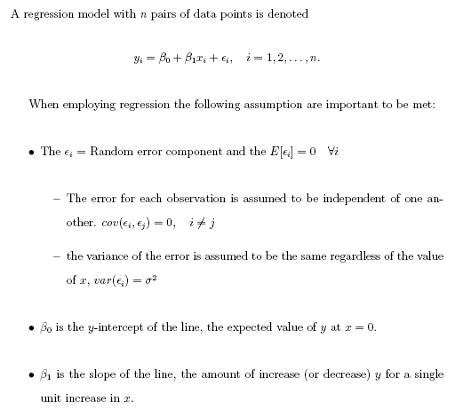
Regression

Slide 7
Solve slope and intercept only using the concept. No calculator needed
X | Y
0 1 2 3 | 2 3 4 5
Solve for
intercept
slope

Slide 8
X | Y
0 1 2 3 | 2 3 4 5
1
1
1
1
1
1
Solve for

Slide 9
Solve slope and intercept only using the concept. No calculator needed
X | Y
0 2 4 6 | 2 4 6 8
Solve for
intercept
slope

Slide 10
X | Y
0 2 4 6 | 2 4 6 8
2
2
2
2
2
2
Solve for

Slide 11
Solve slope and intercept only using the concept. No calculator needed
X | Y
0 1 2 3 | 4 6 8 10
Solve for
intercept
slope

Slide 12
X | Y
0 1 2 3 | 4 6 8 10
2
2
2
Solve for
intercept
slope

Slide 13
Solve slope and intercept only using the concept. No calculator needed
X | Y
0 1 2 3 | 10 7 4 1
Solve for

Slide 14
X | Y
0 1 2 3 | 10 7 4 1
-3
-3
-3
Solve for

Slide 15
Correlation
1)
2)
y
y
Extremely high Positive Correlated
High Positive Correlation
v
v
x
x
3)
4)
y
y
High Negative Correlation
No Correlation
x
x

Slide 16
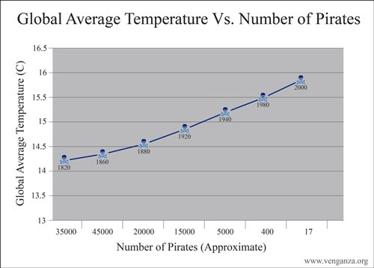

Slide 17
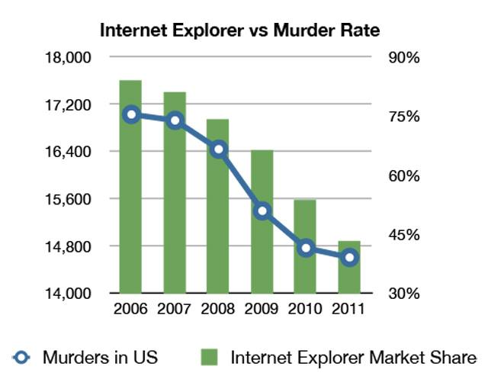

Slide 18
Correlation does not equal causation

Slide 19
Regression
Understanding The Residuals

Slide 20
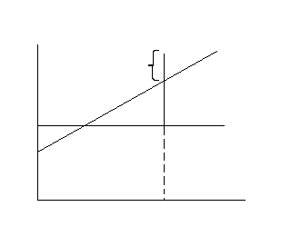
Representation of the regression line
The difference between actual and estimated.

Slide 21
Facts In Regression
The residuals sum to zero.
The residual times x_{i} sum to zero.
The residual times yhat_i sum to zero.

Slide 22
More Facts In Regression
The sum of the y_i equals the sum of the yhat_i
The residuals sum to zero. This is one reason why we look at the sum of the residuals squared. SSE (Sum of Squares Error)
The regression line always goes through the point (xbar,ybar). Thus when x=xbar yhat=ybar. That is if you solve for yhat at xbar you will get ybar.

Slide 23
More Facts In Regression
SST (Sum of Squares Total)
SSR (Sum of Squares Regression)
SSE (Sum of Squares Error)
SST=SSR+SSE

Slide 24
R-Squared
R-Squared is the percent of variation in y explained by the independent variable(s) x.

Slide 25
Adjusted R-Squared
Adjusted R-Squared is adjusted for the number of variables used in the general linear model. The “n” is the sample size and “p” is the number of independent variables in the model.

Slide 26
R-Squared and Adjusted R-Squared
Are measures to indicate how well the model performs. Sample “Goodness of Fit” measures. Does x explain y and if so, how well does x explain y?
R-Squared and Adjusted R-Squared helps to answer this question.
If a variable is added to the model R-Squared will always stay the same or increase.
Adjusted R-Squared helps understand if it is worth adding another variable. A drop in the Adjusted R-Squared leads one to believe that perhaps the additional variable is not helpful in explaining y.
Stepwise techniques can help quickly reduce the number of variables in the model, it is an automated procedure.

Slide 27
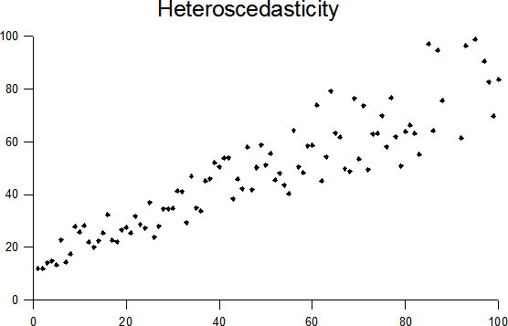
Regression assumes variance of error will be consistent with x.
Transforming the data may help, like taking the natural log of X. For marketing in my opinion this issue isn’t a major concern. In the end you must check model performance and then decide to move forward or not.

Slide 28
Multicolinearity
When two variables are highly correlated and both are in the model they can cause multicolinearity.
Difficult to understand what the individual contribution of a variable is.
Test the correlation among the independent variables to check for multicolinearity.
Possibly drop one variable if they are highly correlated and little value is added by keeping both.

Slide 29
Autocorrelation
This occurs when dealing with time series data:
For example predicting phone usage using previous usage data points.
Time series is beyond this course.
For estimating revenue you may wish to use a simple time series technique such as an exponentially moving average:
You could give a higher weight to the most recent month and less weight to the previous months revenue.
Also, may wish to consider any change in plan, like adding or subtracting cable for a more accurate picture of revenue for customer value.

Slide 30
Sometimes we may wish to make more than one model
Sometimes we may wish to make more than one model.
For example separating out certain customers like platinum package cable renters.
Perhaps they behave differently
It is better to make 2-3 good performing models than a single model that does okay on all the data.
Next few slides illustrate this concept.
There are advanced techniques that can be applied to make a single complicated model.
With 15 million customers to draw from, I don’t believe it is worth the added complication.

Slide 35
outlier

Slide 40
Questioning The Model
Are the assumptions met? What are the assumptions (we haven’t fully discussed this yet, next slide).
Is the model assumed the correct model?
Should transformations be used to create a better model?
Are there outliers and if so should we remove them?
Does the model truly answer the questions you are interested in answering.
Etc.

Slide 41
Incorporating Categorical Data

Slide 42
Categorical Data: Coding
Dummy variables or Indicator variables take values of 0 or 1
Example:
Gender: A possible dummy variable for Gender:
Take 2 minutes and make 3 mutually exclusive categories for highest level education:
Consider only: B.A, M.A., Ph.D.

Slide 43
Categorical Data: Coding
Take 2 minutes and make 3 mutually exclusive categories for highest level education:
Consider only: B.A, M.A., Ph.D.
To create the three different categories you only need two variables.

Slide 44
Ordinal Independent Variable in GLM
If Average Salary
B.A. = 7,000
M.A. = 12,000
Ph.D. = 15,000
B.A.
Increase from B.A. to M.A.
Increase from B.A. to Ph.D.

Slide 45
Change/Increase from B.A. to M.A.
Average Salary
7,000
12,000
15,000
5,000
3,000
Change/Increase from M.A. to Ph.D.
Average Change
When ordinal data is treated as continuous.
Not Good.

Slide 46
Logistic Regression
Understanding the Basics

Slide 47
Logistic Regression - high level
Binary categorical dependent variable
Example churn (churn – yes/no)
Uses many variables to estimate the probability of your dependent variable (e.g. churn).
Can be used to determine if there exists a relationship (+ or -) between certain variables and your dependent variable.

Slide 48
Starting With Simple Logistic Regression Model
The error term does not follow a normal distribution as with linear regression.

Slide 49
Odds and odds ratio

Slide 50
Starting With Simple Logistic Regression Model
This is bounded between 0 and 1. Remember probability can not be smaller than 0 and not greater than 1.
As you can see here the interpretation of the coefficients is very different than with regression.

Slide 51
Starting With Simple Logistic Regression Model
This is known as the logit function. Note: log here is natural log. The logit is linear with the parameters, but this is not the case with the original data.

Slide 52
Starting With Simple Logistic Regression Model: Some Review

Slide 53
Understanding Logistic Regression
First by looking at 2-way tables and using it to understand logistic regression

Slide 54
Starting With Simple Logistic Regression Model:
Using what was just covered solve for alpha and beta
Table of gender by Churn
Gender
(X)
Churn(Y)
Total
Frequency
0
1
0=female
25
5
30
1=male
22
8
30
Total
47
13
60

Slide 55
Starting With Simple Logistic Regression Model:
Hint:
Table of gender by Churn
Gender
(X)
Churn(Y)
Total
Frequency
0
1
0=female
25
5
30
1=male
22
8
30
Total
47
13
60

Slide 56
Logistic Regression Model: Intercept
Table of gender by Churn
Gender (X)
Churn(Y)
Total
Frequency
0
1
This is known as the Log Odds of when treatment=0 equals intercept for a 2X2 table
0=female
25
5
30
1=male
22
8
30
Total
47
13
60

Slide 57
Logistic Regression Model: Slope

Slide 58
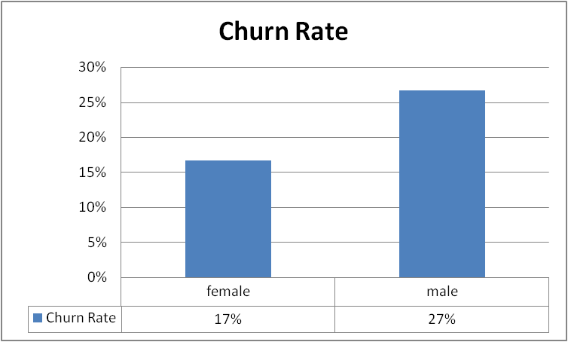
Big picture
Beta is positive – indicating males are more likely to churn than females.
This graph is what you present to explain your findings.

Slide 59
Logistic Regression Model: Slope
Actual SAS output for the previous logistic regression model.
For this model, given it is a 2X2, coded 0,1
Analysis of Maximum Likelihood Estimates
Parameter
DF
Estimate
Standard Error
Wald Chi-Square
Pr > ChiSq
Intercept
1
-1.6094
0.4899
10.7929
0.0010
treatment1
1
0.5978
0.6407
0.8708
0.3507

Slide 60
Building A Fraud Detection Model
What I did at a former company, but easily transferable to the concept of predicting churn. We will discuss.

Slide 61
What is Fraud?
The Data
Fraud:
“A deception deliberately practiced in order to secure unfair or unlawful gain.” (Dictionary.com)
There are different types of fraud committed within the credit industry.
The type of fraud we want to model determines the data needed.
This presentation will focus on the typical application credit card fraud.
This will be defined as someone pretending to be someone else in order to obtain credit and never pays.
We will not cover bust out fraud.
Bust out fraud is when an individual fraudulently obtains credit. The individual is a good customer for a period of time to obtain higher levels of credit. When the credit is limit is high the individual will borrow the maximum amount possible and then not repay.
We will not cover other types of fraud as well.
Should you have questions on any type of fraud please feel free to ask after the presentation.

Slide 62
How Do We Identify Fraud?
The Data
How do we identify fraud?
How do we know the nonpayment is a result of fraud and not a result of a bad risk?
Credit Risk
“The risk that a borrower will be unable to make payment of interest or principal in a timely manner.” (Dictionary.com)
Sometimes an individual will obtain credit legally but be unable to pay, even the first payment.
This is known as first payment default (FPD) when an individual does not make the first payment, but did not commit fraud.
How do we distinguish between fraud and first payment default?
Honestly, it is often difficult to distinguish between fraud and first payment default.

Slide 63
Fraud Vs. Risk
The Data
Fraud and risk are trying to answer two very different questions.
As a result the data required to answer these questions differs as well.
For fraud we desire identification data and credit information.
Even the date of the data desired is different.
The most recent data is desired for fraud.
For risk we desire prior credit information.
Even the date of the data desired is different.
The flag (Good/Bad) should be present date, but the independent variables should be dated 6 to 12 months prior.

Slide 64
The Data

Slide 65
Loan Default Risk and Churn Data
The Data
For correlation use present data for everything.
For prediction use historical data for the independent variables and current data for churn.
Do you want to learn the characteristics of customers before they churn or before they default on a loan?
Then use perhaps 2 month or 3 month old data for the independent variables to predict churn.
From memory we used 6 month old data for predicting risk in credit scoring.

Slide 66
Creating A Good Statistical Model
The Data
Many techniques used to create a good statistical model are useful to create a fraud detection model.
A good statistical model starts with good data.
Again the old saying garbage in garbage out (G.I.G.O.)
What is my point with this statement:
The message is that if the data collected is not good that the model is not expected to be good.
Why is this of concern in fraud detection models?
We need to distinguish between fraud and first payment default. If we combine fraud with FPD it is like trying to create a single model to determine risk and fraud.
This can be done but it will create a model that does not work well on either risk or fraud. It is better to create two separate models instead.
We need our independent data to also be accurate.
If our database determines the application contains incorrect information, it is important that this is not an error within the database.

Slide 67
Why Create Separate Models
The Data
Why not create a single model to eliminate all potential bad clients?
Why separate FPD from fraud in the data?
Why not a single model to identify fraud and risk together?
Benefits of Creating Two Models
Clearly identify which factors are indicators of fraud and which are representative of risk.
A large part of good model building is understanding why a variable belongs in the model. This is very difficult to do when you build a model to answer multiple issues, such as fraud and risk together.
Only with a lot of model building experience on fraud and risk separately would you be confident in statements about the variables.
Some variables may be driven by both fraud and risk, but determining which, fraud or risk, had a stronger influence on the variable selection would be difficult.
The losses due to fraud and risk are not the same.
The number of observations of fraud is often much lower than that of risk. Typical models built on risk use 10,000 observations of “bads” due to risk. Often it is difficult to obtain even 1,000 “bads” due to fraud.
Creating a model using 500 “bads” from fraud and 9,500 “bads” from risk would create a model that focuses on risk.
Creating a model using 500 “bads” from fraud and 500 “bads” from risk just to keep the numbers from fraud and risk equal is also not a good solution.

Slide 68
Separating Fraud and FPD
The Data
As stated earlier it is important to differentiate between FPD and fraud when building a fraud detection model.
In addition, we would remove the FPD data from the model building process.
In truth some FPD are probably unidentified fraud.
If we treat FPD as non-fraud when building the model we would have some frauds listed as both fraud and as non-fraud.
This is very bad to have when building a model.
The statistical model will contain variables to differentiate between frauds and non-frauds.
This will be more difficult to create if many frauds are labeled as non-frauds.

Slide 69
Data Required
The Data
Some of the data needed for fraud detection is different from that of risk.
Important data on fraud detection tends to be identification information.
In the application for credit identification information is collected.
The identification information is then comparable to a large database containing people’s identification information.
Difference between the identification information from the application and that of the database are signs of potential fraud.
When building a risk model, identification information is not needed. With a risk model, it is believed the person is who he say he is, but the concern is that he will not repay money borrowed.

Slide 70
Know The Data You Have
The Data
Know your data.
What is the percent of success in the dependent (fraud) variable?
What are the values of the independent data?
Min, Max, Mean, Median.
Default values, are there any? How will you handle these values?
Example of a default value: Age unknown given a value of zero in the data.
Outliers – do they exist? How will you handle these values?
The handling of outliers will depend on how you will use your model. In practice often “capping” is used. Example, any number greater than the 99th percentile is set equal to the 99th percentile.
As with normal linear regression it is risky to extrapolate to values of the independent variable that weren’t used in the model development.

Slide 71
What Technique To Use To Detect Fraud?
The Technique
Honestly as stated earlier there is more than one way to build a model to detect fraud.
The standard at my old company was logistic regression.
Logistic regression is used when there is a binary response variable, such as fraud.
Binary response means there are two possible outcomes. In our case fraud and not fraud.
Other possible techniques include decision trees and neural networks.
We felt and from some investigation that there was not an advantage to the other techniques.
In business: “Time is money”. In data mining we often do not have enough time to try all three and compare results.
On a few projects though we compared results of other techniques to logistic regression. There was no evidence that the other techniques were better than logistic regression.

Slide 72
Creating a Logistic Regression Model
The Technique
Create an Estimation and Validation Sample.
This step is very important when creating a model to be used in the future.
Validity – “The extent to which a measurement is measuring what was intended.” – Dictionary of Statistics B.S. Everitt. In other words does the model truly differentiate between success and failure?
What is an Estimation and Validation Sample?
How many people have heard of a validation sample?
Oddly enough it was not covered much in graduate school, more briefly mentioned.
A validation sample is necessary when building a model to be used in practice.
Validations are discussed much more greatly in fields that apply statistics.

Slide 73
Creating a Logistic Regression Model
The Technique
What is an Estimation and Validation Sample - continued?
Estimation sample - The sample used to determine the parameters in the model.
Validation sample – The sample used to determine if the model produces consistent results. Will it perform well in practice, on another set of data? The validation sample is another set of data used to answer investigate this question.
Note: If the data is biased in general then the validation sample will not help in determining this. Example:
No women in all your data. It is not possible to know what will happen when the model is applied to all people. The validation sample has the same limitation as the estimation sample, thus the validation sample is not informative here.

Slide 74
Creating a Logistic Regression Model
The Technique
Now that we know what an estimation and validation sample is how do we create them?
The easiest sampling method is simple random sampling.
A more commonly used sampling design is stratified sampling.
Stratify your population into 2 groups, successes and failures.
When ample data is available sample 10,000 successes and 10,000 failures for the estimation and another 10,000 successes and 10,000 failures for the validation. Keep track of proportion of successes in your population relative to the number of successes sampled. Do the same for failures.
Often there is not enough data, often you will not have 10,000 frauds. Usually one group will have a lot and another group will have very few. For the group with a lot you need not sample beyond 10,000. This is an opinion, and it depends in part on how many variables you plan to use in your model.
In my opinion when data is rare, small in quantity:
I create a larger estimation sample than validation sample. Personal preference, haven’t read anything but it is preferred in practice.

Slide 75
Creating a Logistic Regression Model
The Technique
Many people feel with modern computers sampling is not needed. Sampling is still needed:
Without sampling you would only have an estimation sample and no validation sample.
When dealing with millions of records, sampling can greatly aid in the speed of the analysis.
Note: Many companies do not even have the latest and greatest in terms of computers. Many consultants work on their laptops, etc.
Ultimately, when the model finished it is run on the entire dataset.

Slide 76
Variable Selection
The Technique
Often in practice we use brute force to create a model.
Example: We have 500 variables or more and then try all in the model.
We use Stepwise Logistic Regression to eliminate most of the variables and determine the best 15-20 or so most important variables.
Stepwise logistic regression is standard in most common software packages.
Honestly, in SAS for the speed we use a procedure called StepDisc first to come up with the first top 60 variables and then do Stepwise Logistic Regression.
Investigate the variables selected do they make sense.
For example: A mismatch with zip code on the application and zip code in the database should have a positive relationship with the presence of fraud. A negative relationship would make us question the results.

Slide 77
How Good Is the Model
The Technique
How do we know if the model is a good predictive model, or does it need more work?
First what is good?
Does the model distinguish/separate between the two groups (logistic 2 categories)
How do we tell if it is good?
Does the model validate well?
Do the statistics to test the model appear similar on the estimation and validation samples
Most important of all: Does the model distinguish/separate between the two groups (logistic 2 categories)
We will see what happens if we remove or change some of the less important variables in the model and compare results.
We will cover ways to determine how good the model created is in the following slides.

Slide 78
How Good Is The Model: The KS Statistic
The Technique
What is the KS statistic?
It is the Kolmogorov-Smirnov two sample method
“A distribution free method that tests for any difference between population probability distributions. The test is based on the maximum absolute difference between the cumulative distribution functions of the samples from each population” – Dictionary of Statistics B.S. Everitt
A common statistic used to understand the predictive power of a model.
How does it work?
Two cumulative distribution functions can be created, one from the successes and one from the failures. From logistic regression we estimate the probability of success and the probability of failure. Consider the probabilities of failure as the “random variable” then from this we can create two cumulative distribution functions one for the successes and one for the failures.
This will be illustrated on the next slide.

Slide 79
The KS Statistic
The Technique
1st what is the KS statistic?
2nd does it look like this logistic model is predictive? Take a minute or two to think about this question.
A 10 is the lowest probability of fraud and a 1 is the highest probability of fraud.

Slide 80
Calculating the KS statistic
The Technique
Yes this model is terrible, it doesn’t predict anything.
KS statistic = 0.0%

Slide 81
Example of a Non Predictive Model
The Technique
Below is another example of a non predictive model using more realistic numbers. This data assumes a 4% fraud rate.

Slide 82
The KS Statistic
The Technique
Let us try again.
Does it look like this logistic model is predictive?

Slide 83
The KS Statistic
The Technique
It does look predictive
A total 83 good loans out of 100, 83%, were placed into score categories 10-7.
A total 73 frauds out of 100, 73%, were placed into score categories 3-1.

Slide 84
Calculating the KS Statistic
The Technique
This is a very good model. You can see this, you don’t even need the KS statistic. This is an example of how important presentation is for understanding. The way in which we display the data allows us to quickly understand the predictive power of the model.
KS statistic = 75.0%

Slide 85
How is it Applied?
The Technique
Great, so now what? How do we apply this? Take a minute to think.

Slide 86
How is it Applied?
The Technique
Imagine the rejecting of all loan applicants that are placed into score category 1. You would eliminate 43% of the frauds and not loose a single good loan.

Slide 87
How is it Applied?
The Technique
Interpret Cum Odds
An Estimate of odds
Think about what it means when we cut off the bottom 21.5% in terms of the odds and our example on fraud.

Slide 88
Understanding The Fraud Detection Model Performance
The Presentation
This Model has a KS of 25.82.
By refusing the bottom 10% you would have 32 good loans to one fraud, before 24 good loans to one fraud.
By refusing the bottom 10% of applicants you can reduce fraud by 32% (25,532/80,000)

Slide 89
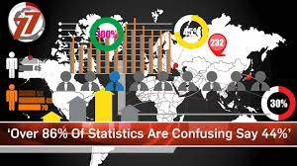

Slide 90
Present the basics to tell a story. Do not present advanced statistics and confusion. Next class putting it together – presenting to tell a story. Creating business intelligence.

